Slide 1

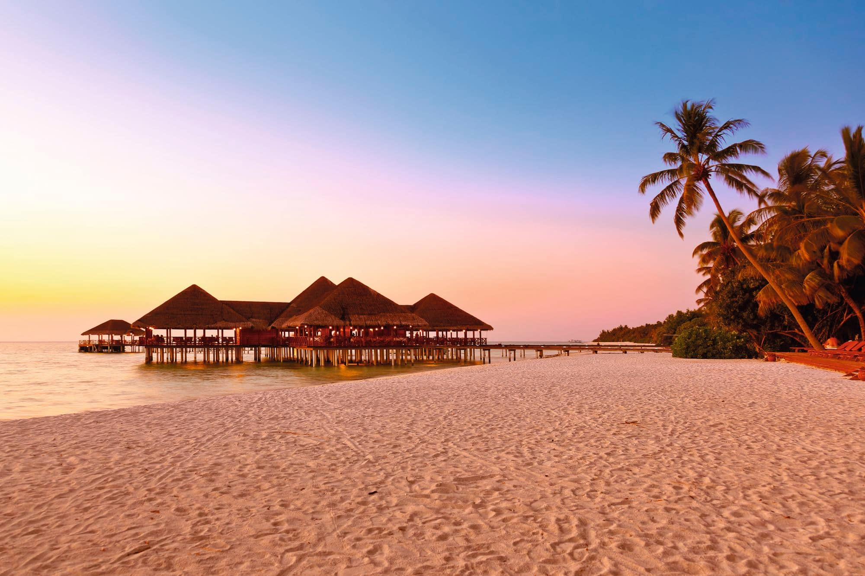
Home Cities Beaches
Best Holiday Destinations
Dvoinishnikov Mikhail 4TPIFI1 HTSTA

Slide 2
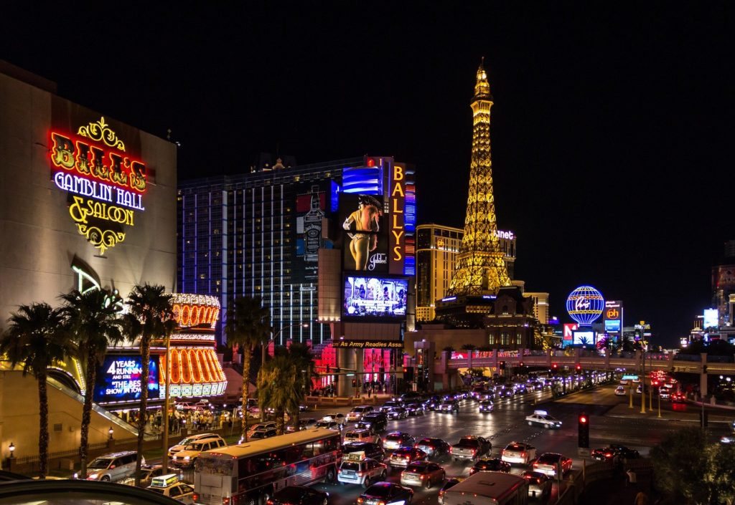
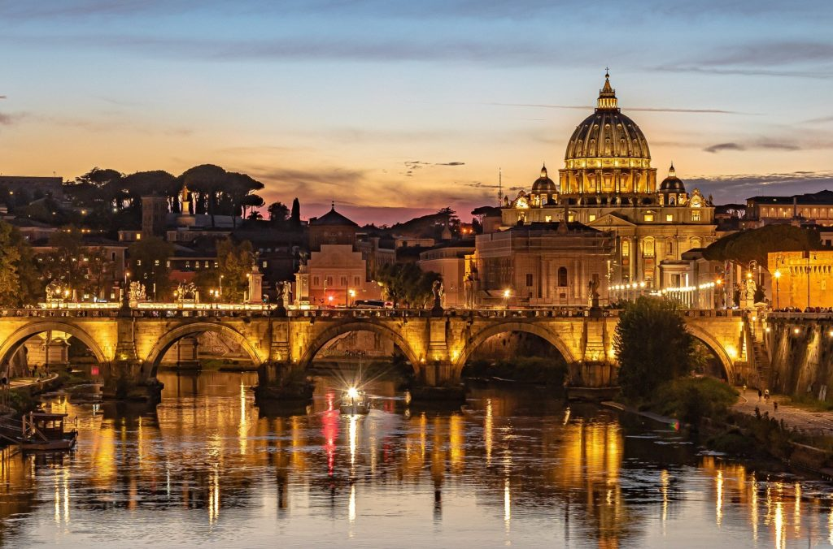
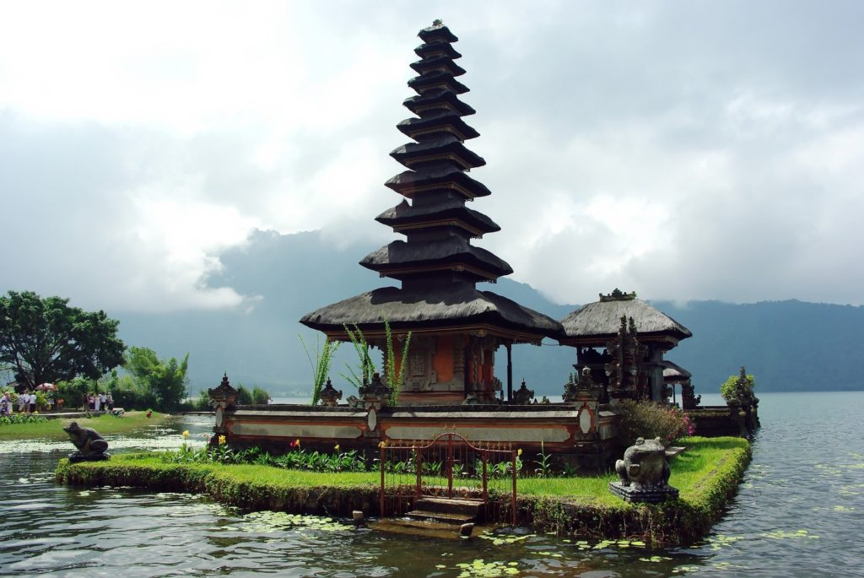
Home Cities Beaches
Las Vegas, The Untied States of America
Rome, Italy
Bali, Indonesia
Dvoinishnikov Mikhail 4TPIFI1 HTSTA

Slide 3
Las Vegas
Home Cities Beaches
Gambling is the first word that comes to your mind after hearing the name of the beautiful city of Las Vegas. It has got something for everybody with different tastes and interests. Luxurious lifestyle, nightlife, drinks, casinos, clubs, games, spa, shopping, food and what not. The hotels in the city are just amazing, the architecture, the hospitality and the world-class facilities that they offer are something to die for. It is known as the entertainment capital of the world because of 24 hours fun-filled activities going throughout the strip for everyone.
What to do:
Casino
Shopping
Night Clubs
Dvoinishnikov Mikhail 4TPIFI1 HTSTA

Slide 4
Rome
Home Cities Beaches
The Eternal City- Rome is famous for its rich ancient culture and heritage, food, culture and the beaches. The beautiful Roman art and culture, the nicely designed museums and palaces, the story of the most important and oldest civilisations, the Romans, the majestic and fascinating architecture, the mouth-watering pizzas, pastas and cheese and premier wines, Gelato- the Italian style ice-cream, the artistic streets, the fashion fiesta and the favourable season throughout the year makes it one of the best and most loved tourist destinations all across the world.
What to do:
Museums
Architecture
Food
Dvoinishnikov Mikhail 4TPIFI1 HTSTA

Slide 5
Bali
Home Cities Beaches
History, culture and food with nature and beautiful beaches is a complete package for a perfect holiday destination. Bali is one of the most popular destinations these days amongst couples and families. Indonesia is itself an island country; therefore, the beaches here are out of the world. The beaches have a huge variety from the calm ones to the black volcanic ones in the city of Bali. Dry season of May to September is the preferred time for travellers due to low humidity.
What to do:
Mountains
Food
Surfing
Dvoinishnikov Mikhail 4TPIFI1 HTSTA

Slide 6
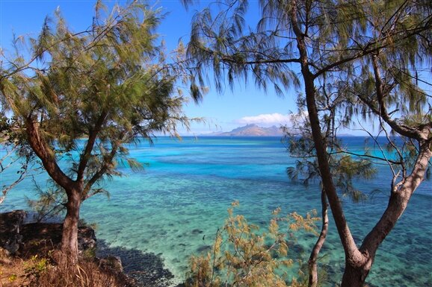
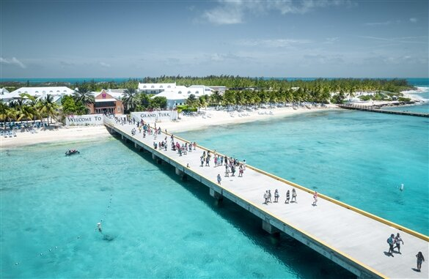
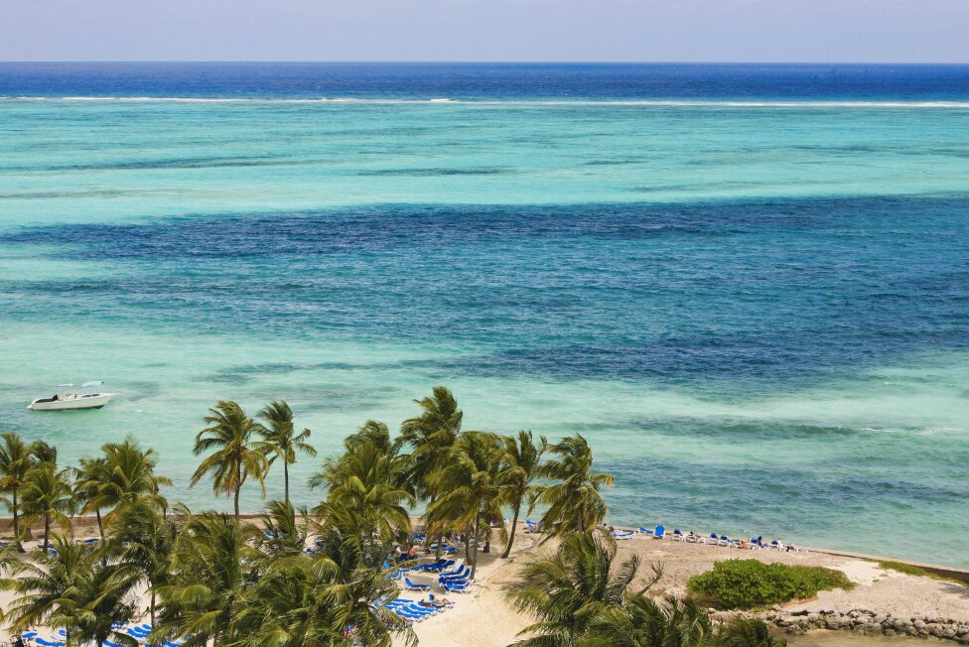
Home Cities Beaches
Fiji
Turks & Caicos, British overseas territories
Bahamas
Dvoinishnikov Mikhail 4TPIFI1 HTSTA

Slide 7
Fiji
Home Cities Beaches
With its turquoise waters, glittering sands and luxe resorts, Fiji is similar to many other tropical getaways. Likewise, the set of 333 islands caters to lovebirds of all kinds. Plus, adventure-seekers, like surfers and divers, appreciate the archipelago’s quality waves and coral reefs. Since it's more than 1,300 miles from New Zealand's North Island in the South Pacific Ocean, Fiji affords you the delectable feeling of seclusion. Fijian customs will make you feel a million miles away too: Ever tasted the dizzying kava drink? If not, it's about time you did.
What to do:
Surfing
Swimming
Beaches
Dvoinishnikov Mikhail 4TPIFI1 HTSTA

Slide 8
Turks & Caicos
Home Cities Beaches
The Turks & Caicos Islands have the perfect antidote for your hectic lifestyle: blindingly white sand fringed by shimmering azure water, colorful coral reefs, crispy conch fritters and an easygoing vibe – despite its knack for attracting the rich and famous to its shores. Turks & Caicos holds tight to its reputation as an exclusive and secluded getaway, and regular vacationers to these skinny strips of alabaster sand will tell you that they wouldn't have it any other way.
What to do:
Museums
Reefs
Sunbathing
Dvoinishnikov Mikhail 4TPIFI1 HTSTA

Slide 9
Bahamas
Home Cities Beaches
The roughly 700 islands that make up the Bahamas lure millions of visitors to this paradise's white sandy shores, duty-free shops, fishing and scuba diving excursions and luxurious accommodations each year. Nature enthusiasts can explore pristine protected areas like the Leon Levy Native Plant Preserve (on Eleuthera) and Lucayan National Park (on Grand Bahama Island) or take it easy at one of the country's many beaches or private islands. Meanwhile, history buffs can explore the ruins and artifacts from the colonial era and indigenous peoples like the Lucayan Indians.
What to do:
Shopping
Scuba Diving
Swimming
Dvoinishnikov Mikhail 4TPIFI1 HTSTA

